Slide 1
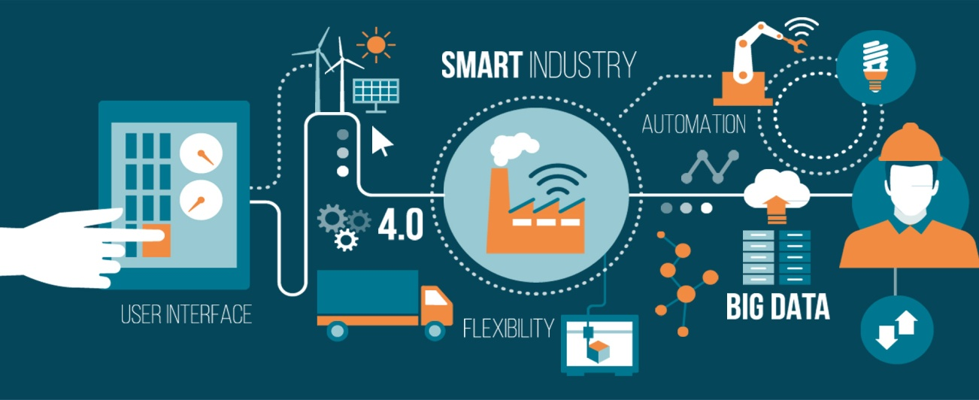
Software Project Basics
Mastering Software Project Management Murali K, Chemuturi, Thomas M. CagelyJr, J. Ross
Prepared by: Sushish Baral

Slide 2
Contents
Introduction
Types of Software Projects
Classification of Software Projects
  Based on Software Development Life Cycle
  Approach Driven
  Maintenance
  Web Application
  Agile Development

Slide 3
Introduction
Human endeavor, from its earliest hunter/gatherer roots, was carried out in teams, each with a hierarchy of roles.
As civilization progressed, the need for structure and rules increased.
These developments were the genesis of the art and science of managing production, which has been called production management.

Slide 4
Classification of Organization
(Based on Goods Produced)
Mass Production
  Continuously produces the same products.
  Warehouse
  Significance is that the rate of consumption/demand equals or exceeds the rate of production.
Batch production
  Produces in batch, each batch is similar not identical.
  Warehouse
  In batch the rate of production exceeds the rate of consumption/demand for the product.
Flow process production
  Production of chemicals, electricity etc.
  Warehouse
Job order production
  Produces tailor-made goods.

Slide 5
Classification of Organization
(Based on Goods Produced)
“the goal of production management is to balance both rates”
Presently, Management theory address organization in two basic categories,
  production organization &
  service organization
Art and science of managing these organization has metamorphosed from production management to operation management.

Slide 6
Classification of Organization
(Based on Nature of Operation)
Continuous operation
  Day by day
  Stockpiling (warehouse)
  Has fixed facilities that carry out similar operations
Project operations
  Dissimilar to day by day
  Produce against customer order
  Fixed but flexible facilities
Table 1.1. Comparisons of Continuous Operations with Project Operations

Slide 7
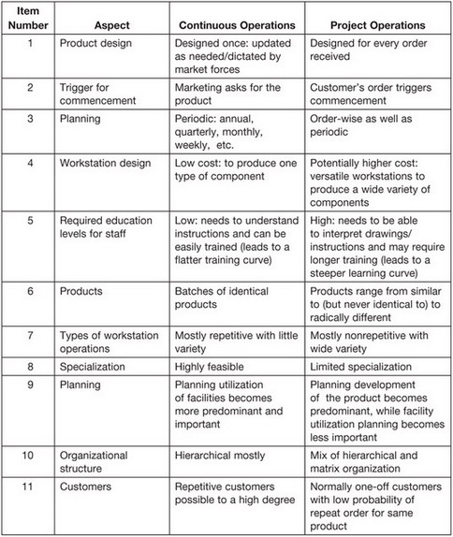

Slide 8
Classification of Organization
(Based on Nature of Operation)
More and more organization are moving towards project operations due to market forces, which put emphasis on individual preferences while reducing costs.
Henry Ford, sr.:”you can have the car of any color as long as it is black”
“mass customization” prevailing on the project operation category
“mass customization” blends the aspect of continuous and project operations.

Slide 9
Description of a Project
A project is a temporary endeavor.
A project has a definite beginning and a definite ending.
No two projects will be identical, although they may be similar.
Each project needs to be separately approved, planned, designed, engineered, constructed, tested, delivered, installed, and commissioned.
A project may be stand-alone or a component in a larger program.
A project is executed in phases, with an initiation phase and one or more intermediate phases and a closing phase.
Many projects have a transition phase (e.g., handover to customer).
A project may extend through a maintenance phase.

Slide 10
Types of Software Projects
Software development projects (SDPs) are not homogenous.
They come in various sizes and types.
  An organization desires to shift a business process from manual information processing to computer-based information processing.
    This project will include studying the user requirements and carrying out all of the activities necessary to implement the computer-based system
  An organization desires to shift a business process from manual information processing to computer-based information processing. The organization does not want the software be developed from “scratch.” It wants to use a commercial off-the-shelf software (COTS) product.
    This project will include implementation and perhaps some customization of the COTS product to make it appropriate for the organization.

Slide 11
  An organization has a computer-based system that needs to be shifted to another computer system because the existing system has become obsolete and support to keep the obsolete system in working condition is no longer available.
    This project could include porting the code, training users, and testing the new implementation.
  An organization has a computer-based system and desires to shift it from a flat file system to a RDBMS-based system (relational database management system).
    Activities will include data conversion in addition to other activities.
  An organization has a computer-based information processing system and needs to effect modifications in the software or add additional functionality.
    Activities include adding functionality and making required modifications in the software of a third party (if required).
  An organization has developed a computer-based information processing system and wants to get it thoroughly tested by an independent organization.
    Activities will include testing and interfacing between the organizations.

Slide 12
Classification of Software Projects
Software development life cycle(SDLC) projects
  Full life cycle
  Partial life cycle
Approach driven software development projects
  “Fresh” development(creating the entire software from “scratch”)
  COTS (Commercial Off-the-shelf) Product customization/implementation
  Porting
  Migration
  Conversion of existing software to meet changed condition such as Y2K and Euro conversion.
Maintenance
  Defect repair
  Functional expansion
  Operational support
  Fixing old behavior
  Software modification
Web application projects
Agile development projects

Slide 13
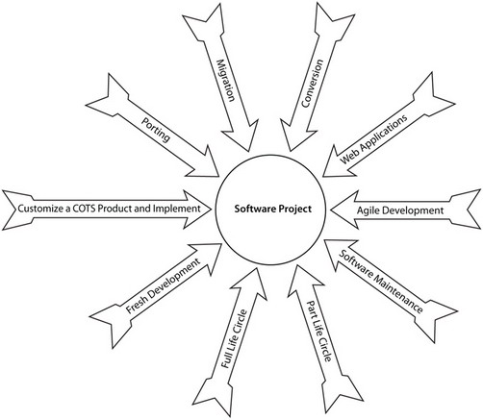
Figure 1.1. Software project types.

Slide 14
Software development life cycle(SDLC) projects
Full life cycle: (starts at the beginning and ends at the end)
Generally agreed is that user requirements analysis, software requirements analysis, software design, construction, and testing (regardless of what they are called) are parts of a SDLC.
Some of the components of an SDLC that remain in question include:
  A feasibility study
  Special testing that is beyond unit testing
  Implementation,
  Software commissioning, user training, pilot runs, parallel runs, etc.
Notes:
In many instances, when the end product is used within the same organization, these four components are considered part of an SDLC. Alternately, in other circumstances, these components are excluded for organizations that specialize in software development and/or develop software for use by a different organization (unless contractually included or part of a software as a service architecture).

Slide 15
Software development life cycle(SDLC) projects
Partial life cycle:(include only a portion of the SDLC)
Testing projects
  (Unit testing and code walk-through are normally not included in this type of project.)
Independent verification and validation
  including code walk-through and other forms of validation to determine the efficiency of coding
A project divided between two or more vendors based on the specialty to derive the advantages of best practices developed through specialization which can lead to defining the project by phase or by combination of phases, such as:
  Requirements analysis
  Design
  Software construction
  Testing

Slide 16
Approach driven software development projects
Fresh or new software development projects. Fresh or new software development projects are identical to full life cycle development projects previously discussed.

Slide 17
Approach driven software development projects
(COTS Product customization/implementation)
ERP (enterprise resource planning software, e.g., by SAP and PeopleSoft), CRM (customer relationship management), SCM (supply chain management), EAI (enterprise applications integration), and data warehousing software
Typical phases in these projects include:
  Current system study
  Gap analysis
  Customization report
  Statement of work
  Design

Slide 18
Approach driven software development projects
(COTS Product customization/implementation)
  Construction and integration
  Testing
  Custom code integration
    (in some cases it can include building a layer over the COTS product and integration of custom developed code into the source code of the COTS product)
  COTS source code modification (rare)
  Implementation
  Training
  Transition of the system

Slide 19
Approach driven software development projects
(Porting) moving software from one hardware platform to another hardware platform
Changes in programming language
Differences between implementations
Manual intervention to make the existing software work on new hardware without issues
Project execution work in a porting project involves:
  Documenting the differences between the two versions of the programming languages
  Developing a software tool to make corrections in the code based on the details mentioned above
    (Sometimes, vendors of the programming language supply this type of tool.)

Slide 20
Approach driven software development projects
(Porting)
  Execution of the software porting tool to make all possible corrections
  Manual correction to make any specific corrections needed
  Conducting the specified software tests
  Modifications to the software engineering documents required to reflect the changes made in the software
  Conducting acceptance testing
  Delivery of the software

Slide 21
Approach driven software development projects
(Migration)
Software migration is the practice of transferring data, accounts, and functionality from one operating environment to another
To take advantage of new features and facilities provided in the newly released version
It could also refer to times when users are migrating the same software from one piece of computer hardware to another, or changing both software and hardware simultaneously.

Slide 22
Approach driven software development projects
(Migration)
To take advantage of new facilities and features available in the newer version, manual changes are typically required and involve:
  Studying the new version
  Deciding which new features
  Developing a functional expansion design document detailing the new features
  Running and upgrading the software (if an upgrade tool is provided by the vendor)
  Implementing the functional expansion design (may also include correcting the existing code)
  Conducting all the tests necessary to ensure that the software delivers all the functionality

Slide 23
Approach driven software development projects
(Migration)
Conducting acceptance testing and delivering the software
Data migration involving (sometimes the project scope may include data migration):
  Mapping the old database schema to the new database schema
  Developing software/locating tools provided with the new database (if any) to migrate data from the old database to the new database
  Running the tools to migrate data from the old database to the new database
  Arranging for data entry in the new database for those fields that are absent in the old database, but present in the new database
  Testing the database for known cases using the software, comparing the results with the desired results, and making necessary changes so that the new database is correct
  Integrating the database with the software

Slide 24
Approach driven software development projects
(Migration)
Note: Porting and migration projects are similar. There is no strict distinction between the two. Therefore, these two terms are sometimes used interchangeably.

Slide 25
Approach driven software development projects
(Conversion)
Using a Y2K project as example, the work includes verifying all programs for code limitations and then making any necessary modifications.

Slide 26
Approach driven software development projects
(Conversion)
Typical activities in a conversion project include:
  Studying the existing software and specifications of the necessary conversion
  Preparing a conversion guidelines document
  Developing a tool (if feasible) to automatically incorporate the modifications in the software
  Running the tools or hand coding the changes
  Performing a manual walk-through of each program to locate the remaining required modifications and implementing them
  Conducting unit testing (and other tests as specified or as necessary)
  Conducting acceptance testing
  Delivering the software

Slide 27
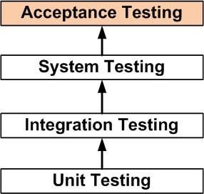

Slide 28
Maintenance
contract between the parties to take care of a specific application for a given period of time
a maintenance work request (MWR) triggers software maintenance work. An MWR can be known by other terms, depending on the organization:
  Program modification request (PMR)
  Program change request (PCR)
  Defect report
  Software change request

Slide 29
Maintenance(Defect Repair)
Defect fixing work involves fixing a reported defect. A defect may be classified as:
  Critical (a “show-stopper”)
  Major (hinders smooth functioning of work)
  Minor (mostly a nuisance; work is not affected)

Slide 30
Maintenance(Defect Repair)
Generally, the steps in fixing a defect include:
  Studying the defect report
  Replicating the defect scenario in a development environment
  Studying the code
  Locating the defect
  Fixing the defect, conforming to code change guidelines
  Arranging for peer review and implementing feedback (if any)
  Arranging for independent regression testing and implementing feedback (if any)
  Delivering the fixed code to production for implementation in the production system
  Closing the request

Slide 31
Maintenance(Functional Expansion)
When additional functionality is required in existing software, functional enhancement is the tool to achieve it.
Work included in functional enhancement includes:
  Adding a new screen or report
  Adding additional processing functionality (e.g., quarterly/half yearly/ yearly processing)
  Adding a new module in the software
  Integrating with another software
  Building interfaces with other software
  Adding new hardware and building an interface to the new hardware in the existing software

Slide 32
Maintenance(Operational Support)
Operational support is similar to defect fixing
Activities under operational support include:
  Running periodic jobs (end of day/week/month)
  Taking backups
  Restoring from backups
  User management functionality (including creation, deletion, and suspending of user accounts and changing access privileges, etc.)
  Providing “hand-holding” assistance at a specific workstation
  Extracting data and producing an ad hoc report on an urgent basis
  Providing a temporary patch so that operations may continue
  Investigating operational complaints

Slide 33
Maintenance(Fixing Odd behaviors)
In large, complex software systems, and in systems that have been in existence for many years and have undergone software maintenance (e.g., defect fixes, software modifications, and functional expansions), random defects may often crop up under some circumstances, but not in others.

Slide 34
Maintenance(Fixing Odd behaviors)
General steps in fixing odd behavior include:
  Studying the odd behavior report
  Trying to replicate the behavior scenario in a development environment
  Studying the code
  Listing all possible alternative reasons for the reported behavior
  Reviewing the code for each alternative for possible opportunities for improvement
  Iterating/eliminating all causes, one by one
  Fixing all possible opportunities for code improvement
  Arranging for peer review
  Arranging for independent regression testing
  Delivering the software to production for implementation of improved code in the production system
  Waiting for another report of the identical odd behavior and repeating all the above steps.
  Keeping the request open through a period of observation

Slide 35
Maintenance(Software Modification)
Modification of working software is necessitated due to:
  Changes in requirements mainly due to changed conditions occurring over a period of time
  Changes in business processing logic
  Convenience for users
  Changes in statutory requirements

Slide 36
Maintenance(Software Modification)
Steps in the process of software modification include:
  Studying the software modification request
  Analyzing the existing software to identify components that require modification
  Preparing a design modification document and obtaining approval from appropriate executives
  Implementing the approved design modification in the code
  Arranging for peer review of the modified code
  Arranging for independent functional testing of the modified functionality — to ensure that it conforms to the approved design document — and implementing feedback (if any)
  Arranging for independent regression testing and implementing feedback (if any)
  Delivering the modified artifact to production for implementation in the production system
  Closing the request

Slide 37
Web Application Projects
Web projects differ from other projects because they have more than two tiers:
  Presentation tier
  Database server tier
  Application server tier
  Web server tier
  Security server

Slide 38
Web Application Projects
A Web application consists of:
  HTML pages that include graphics to enhance the “look and feel” of the Web pages
  Backend programs for data manipulation
  Middleware programs for application server or rules engines
  Middleware programs for security management
  Other application-specific programs

Slide 39
Web Application Projects
Another notable feature of Web applications is that backend programming and middleware programming may be in different programming languages and may require persons with different skill sets, even for the same project. Another request is for independence from databases and Web browsers, which necessitates coding routines that are not oriented toward functionality.

Slide 40
Agile Development Projects
Agile software development refers to a group of software development methodologies based on iterative development, in which requirements and solutions evolve through collaboration between self-organizing, cross-functional teams.

